Slide 1
Data Engineering
Gen-Tao Chiang
Data and Analytic Engineer
Data Science Africa 2018

Slide 2
Outline
Data Engineering
Architecture
Explorer Data
Kibana
Logstash
Python

Slide 3
Data Engineer

Slide 4
Data Engineer
Role
To build a system and pipelines that transform that data into formats that data scientists can use.

Slide 5
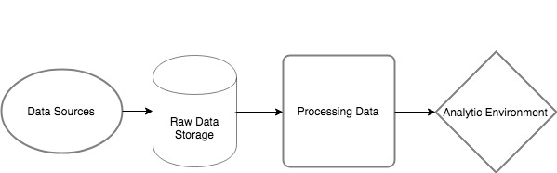
Data Engineer
Typical pipeline
Notes:
Data sources: API, IoT devices, mobile, logs, CSV, streaming data or batch data
If this streaming data, which tool we are going to use? Kafka, RabbitMQ, Fkuend?
Raw data storage: SQL database (Mysql PotsgreSQL, Redshift), S3, HDFS, NoSQL(mongodb, elasticsearch)
Processing: Hadoop, Spark,
Analytic environment: (BI, tableau, serving ML models?)

Slide 7
Data Engineer
Responsibilities
Developing and choosing correct tools for collecting data from different sources. If needed, combining data from different sources.
Architecting scalable distributed systems.
Architecting the data store.
Creating reliable data pipeline.
Working closely with data scientists to provide right tools and solutions.

Slide 8
Data Engineering
Useful Tools
SQL : MySQL, PostgreSQL, Redshift, Hive
NoSQL: MongoDB, ElasticSearch, Cassandra, InfluxDB
Big data solutions: Hadoop, Spark
Programming: Python, Scala
Notebook: Jupyter, zeppelin
DevOps, or Cluster Management: Docker, Linux System Administration, Jenkins, Kubernetes, Yarn, Mesos, Terraform.
Cloud Computing: AWS, Azure
Workflow management, Logstash, Luigi, GLUE
Message queue: Kafka, RabbitMQ, Kinesis.
Business Intelligent and Visualization: Splunk, Tableau, Kibana, D3, Superset..etc.

Slide 9
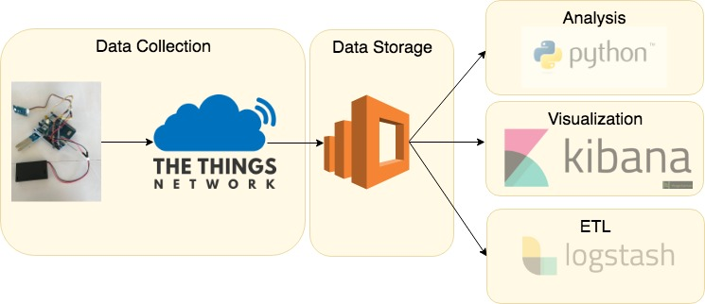
Architecture
Greenhouse and Air quality

Slide 10
Architecture
Data Storage: Elasticsearch
Elasticsearch is a search engine and provides a distributed storage and an HTTP web interface and schema-free JSON documents.
It can be scale up by simply adding more nodes.
You can run Elasticsearch locally or using AWS Elasticsearch service.
https://search-dsa-fx7s43inji63qg3oxxuziwjxa4.us-west-2.es.amazonaws.com

Slide 11
Architecture
Data Storage: Elasticsearch : Create Index and Mapping
curl -X PUT "localhost:9200/greenhouse" -H 'Content-Type: application/json' -d'
{
"settings" : {
"number_of_shards" : 1
},
"mappings": {
"type1": {
"properties": {
"analog_in_4" : { "type": "float" },
"relative_humidity_3": { "type": "float" },
"temperature_2": { "type": "float" },
"app_id": { "type": "text" },
"dev_id": { "type": "text" },
"time": { "type": "date", "format": "strict_date_optional_time" },
………………………….
Notes:
Shrads: split data into how many nodes
Also can specify replica

Slide 12
Architecture
Data Storage: Elasticsearch : List Index
curl -X GET "https://search-dsa-fx7s43inji63qg3oxxuziwjxa4.us-west-2.es.amazonaws.com:443/_cat/indices?v"
health status index uuid pri rep docs.count docs.deleted store.size pri.store.size
yellow open airquality 46OHSD-ASzG3cLWGW2A4Rw 1 1 0 0 230b 230b
yellow open greenhouse2 SLJ7oNS2SqKT-6qkgkKRmA 1 1 2552 0 704.7kb 704.7kb
green open .kibana pn-pPxQVQRO5gxe2C0iyug 1 0 7 1 44.5kb 44.5kb

Slide 13
Architecture
Data Storage: Indexing Data from TTN to Elasticsearch
import ttn from elasticsearch import Elasticsearch
app_id = "dsa2018-greenhouse" access_key = ”ttn-key" index = "greenhouse" doctype = "type1" eshost = "localhost:9200”
es = Elasticsearch( [eshost], scheme="http", port=9200, )

Slide 14
Architecture
Data Storage: Indexing Data from TTN to Elasticsearch
def uplink_callback(msg, client): print("Received uplink from ", msg.dev_id) print("type of msg",type(msg)) doc = { "_op_type": "index", "_index": index, "_type": doctype, "app_id": msg.app_id, "dev_id": msg.dev_id, "hardware_serial": msg.hardware_serial, "counter":msg.counter,
"analog_in_4" : analog_in_4, "relative_humidity_3": relative_humidity_3, "temperature_2" : temperature_2 }

Slide 15
Architecture
Data Storage: Indexing Data from TTN to Elasticsearch
def write2es(documents): helpers.bulk(es, documents, index=index, doc_type=doctype) print("reset docs to 0") global docs docs = []
if len(docs) == 2: print("call write2es") write2es(docs)

Slide 16
Exploring Data
Visualization: Kibana
Kibana is a open source data visualization plugin for Elasticsearch. It provides visualization capabilities on top of the content indexed on an Elasticsearch cluster.
https://search-dsa-fx7s43inji63qg3oxxuziwjxa4.us-west-2.es.amazonaws.com/_plugin/kibana/
Notes:
Choose Index: greenhouse2
Adding fields (counter, app_id, relative_humidity_3, temperature_2, analog_in_4, dev_id)
Define time range (June 1st)
Check data coverage cross the time
Choose your sensor (dev_id:"dsa-greenhouse10")
Limit the moisture data range (dev_id:"dsa-greenhouse10" AND analog_in_4 : [120 TO 121])

Slide 17
Exploring Data
ETL: Logstash
Logstash is an open source, server-side data processing pipeline that ingests data from a multitude of sources simultaneously, transforms it, and then send it to storage.
Three component: input for reading the data, filter for manipulating data and output for sending/storing data.

Slide 20
Exploring Data
input {
# Read all documents from Elasticsearch matching the given query
elasticsearch {
hosts => "https://search-dsa-fx7s43inji63qg3oxxuziwjxa4.us-west-2.es.amazonaws.com:443"
index => "greenhouse2"
query => '{"query": {"range" : {"time" : {"gte": "31/05/2018","lte": "2019","format": "dd/MM/yyyy||yyyy"}}}}'
}
}
output {
stdout { codec => dots }
csv {
fields => ['time','app_id','dev_id','hardware_serial','relative_humidity_3','temperature_2','analog_4']
path => 'dsa-greenhouse.csv'
}
}

Slide 21
Exploring Data
Python
Example: Greenhouse-practice.ipynb
pip install elasticsearch

Slide 22
Asante!

